Slide 1
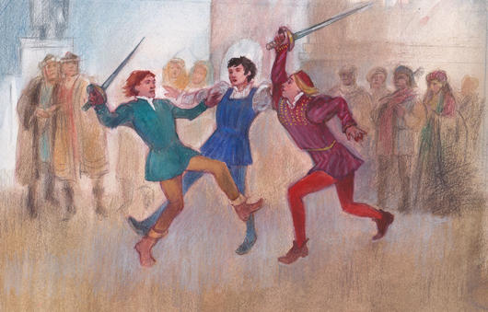
Act 1, Scene 4 & 5: The Capulet Feast [FLE writing in role]
Stop in the name of love!
He started it!
But he bit his thumb at me!
We have already seen how the play opens in the prologue, with key themes such as love and hate introduced to the audience by the chorus. We have also seen the use of ANTITHESIS in the prologue to encapsulate this key opposition in the play. We now plunge into an opening scene of VIOLENCE on the streets of Verona.

Slide 2
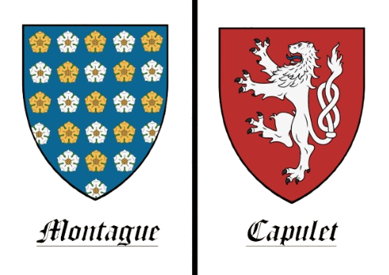






Act I, Scene I-V: R&J Opening
What are these all examples of…?
CAPULETS vs. MONTAGUES
LOVE vs. VIOLENCE
Juxtaposition
Antithesis
MOON vs. SUN
INDIVIDUAL vs. SOCIETY

Slide 3
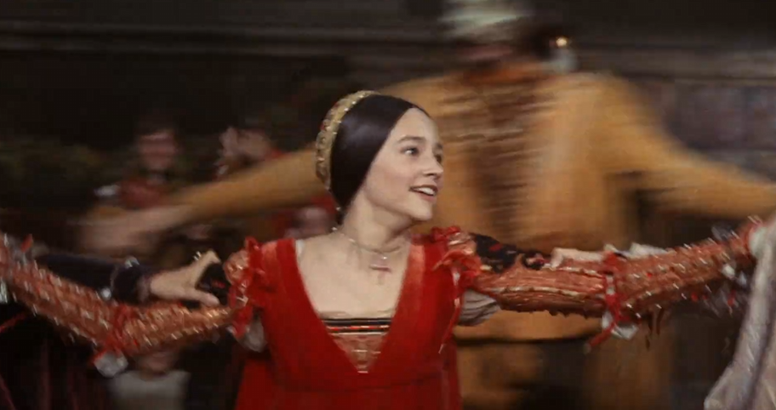
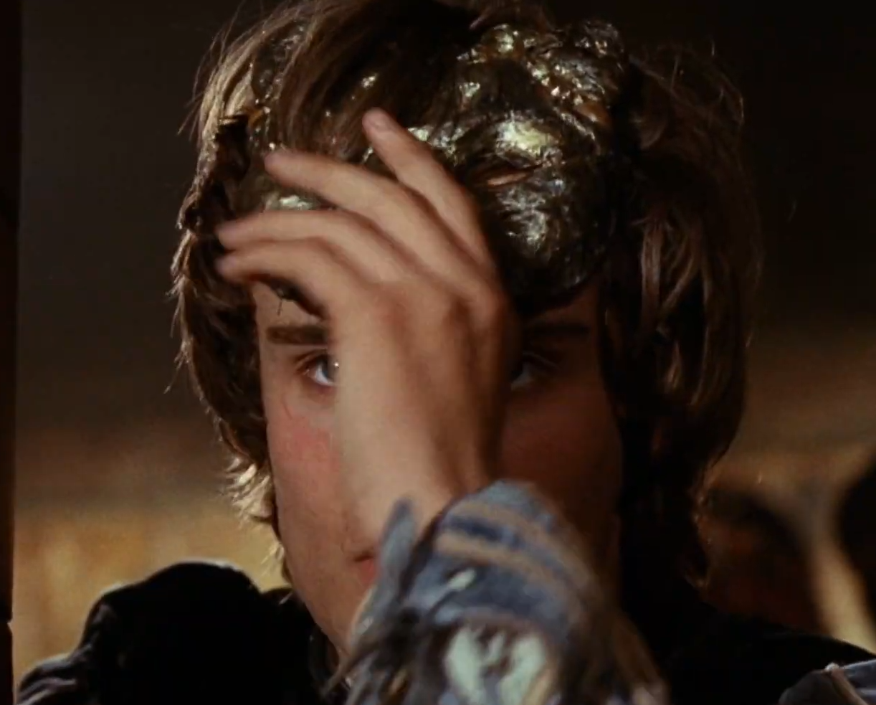
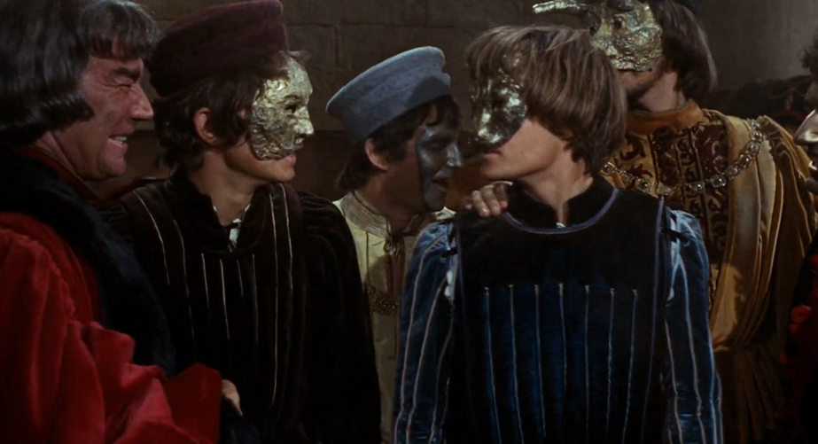
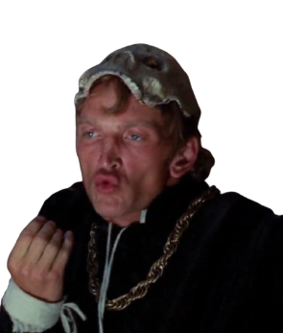
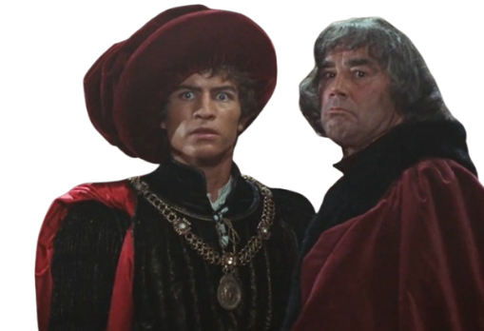

Act I, Scene IV-V: What Happened?
Juliet
Romeo
(5 min) Discuss with the person next to you!
THINK, PAIR, SHARE
What happened at the Capulet Feast in Act 1, Scene 4-5?
Head to page 37-45 of your R&J Cambridge Edt. copy
Lord Capulet
Tybalt
Mercutio

Slide 4


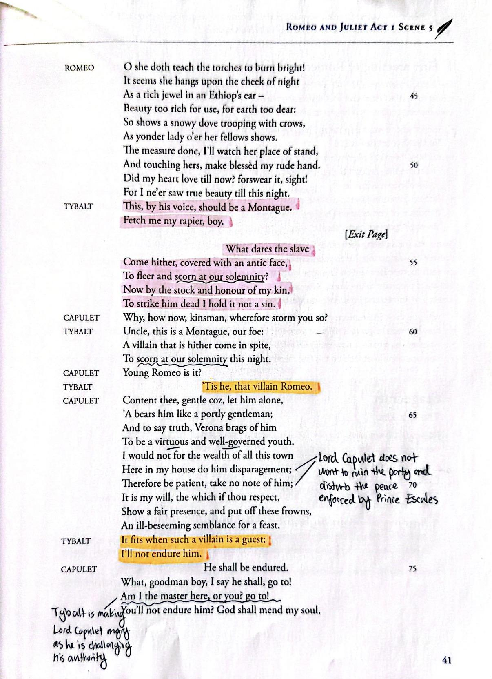
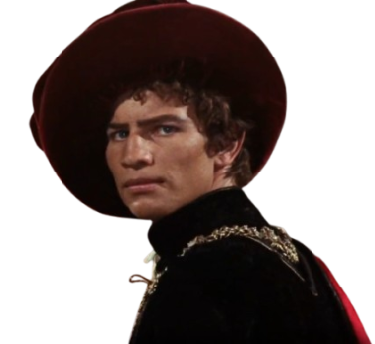

Act I, Scene V: Tybalt’s Fury
Is that a Montague???
@#$%&*!
I must tell uncle! This is a Montague, our foe!
Head to page 37-45, Act 1, Scene 5. Annotate and highlight keywords that reveal what happens to Tybalt

Slide 5
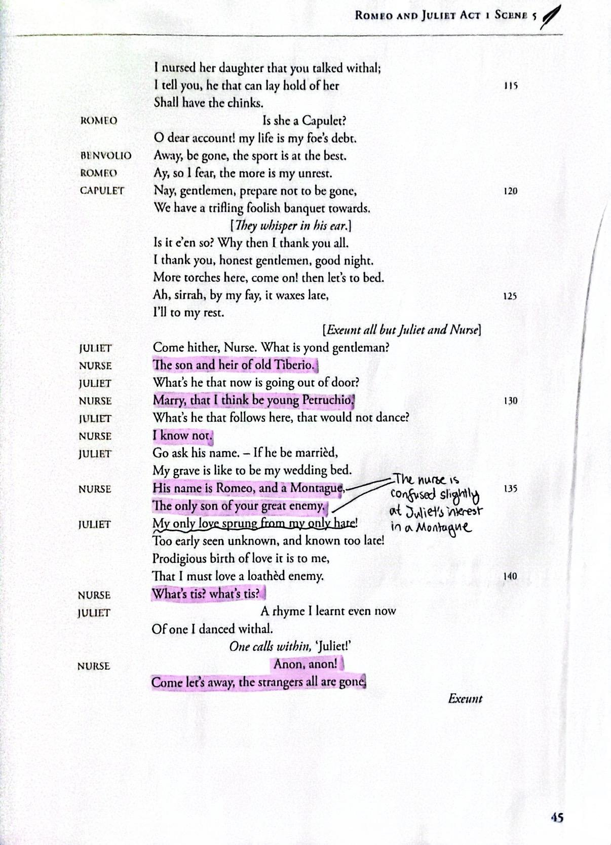

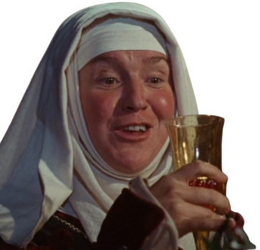
Act I, Scene V: A shocked Nurse
Juliet is my pride and joy! Whoever marries her is a lucky man
“Go, girl, seek happy nights to happy days!”
Head to page 37-45, Act 1, Scene 5. Annotate and highlight keywords that reveal the Nurse’s thoughts on the situation

Slide 6
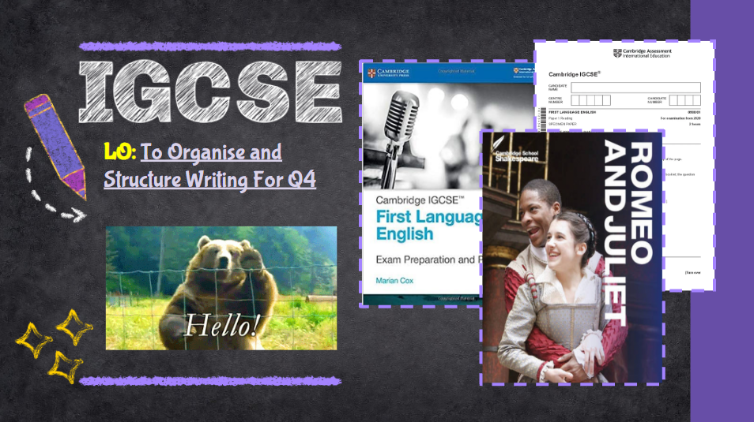
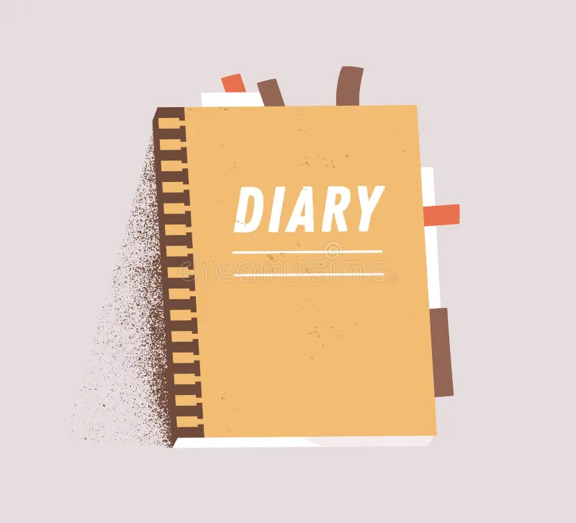





P1 Q4 FLE TEXT TYPES
DIARY or JOURNAL
INTERVIEW
SPEECH
LETTER (informal or formal)
MAGAZINE ARTICLE or NEWSPAPER REPORT
FORMAL REPORT
Spend some time now mind-mapping the conventions and features of each of these text types…

Slide 7
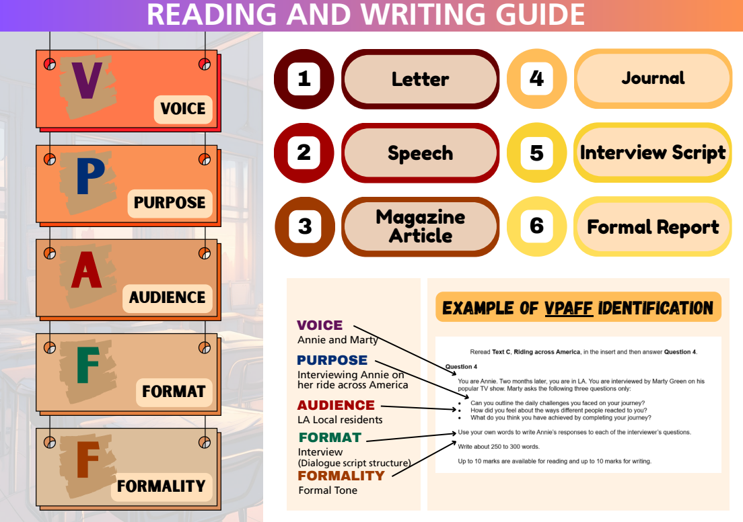
Journal /
Diary

Slide 8
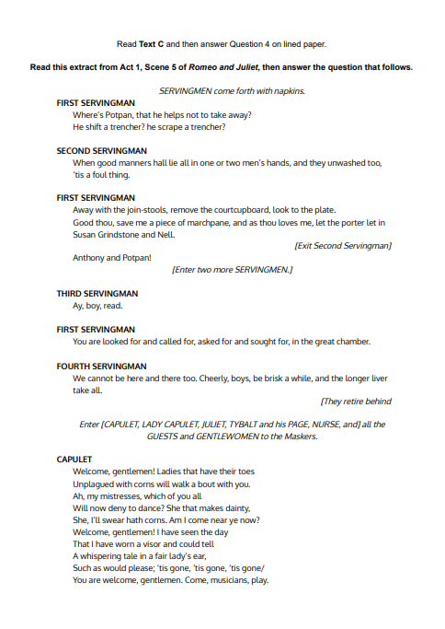
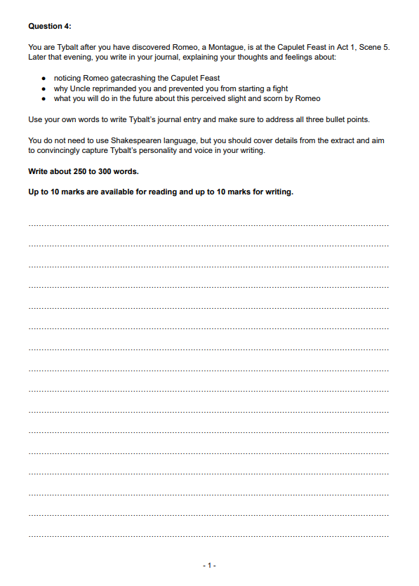
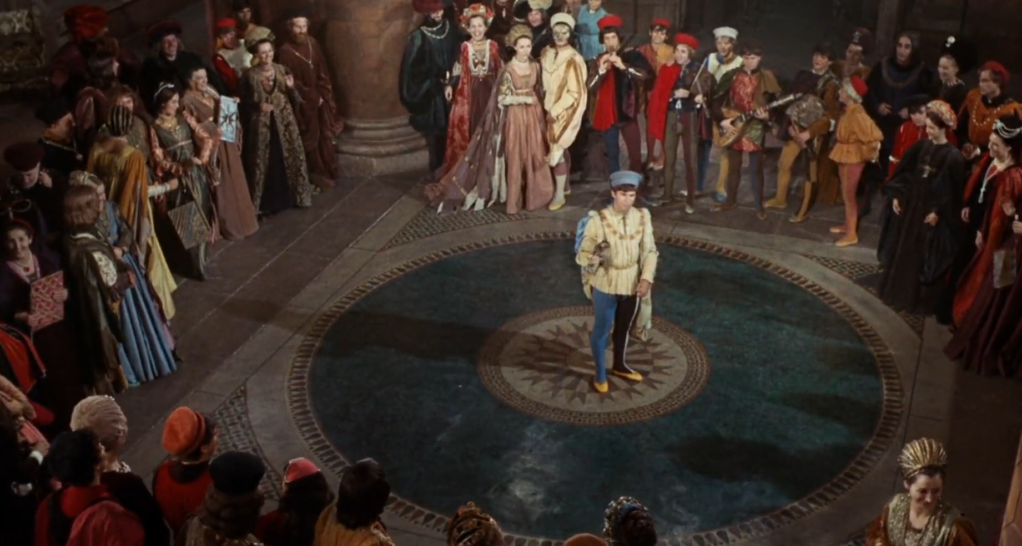

Act I - R&J Empathic Practise
For Question 4 on the FLE Paper 1: Reading Paper, you will need to write in a role!
What might be some things that servants witness?
What do the serving men feel about the feast?
What would be rumours or gossip they observe? Remember they are servants, they would not dare to state things as a fact!
NEW* Capulet Feast Interview (R&J) insert - P1 Q4

Slide 9
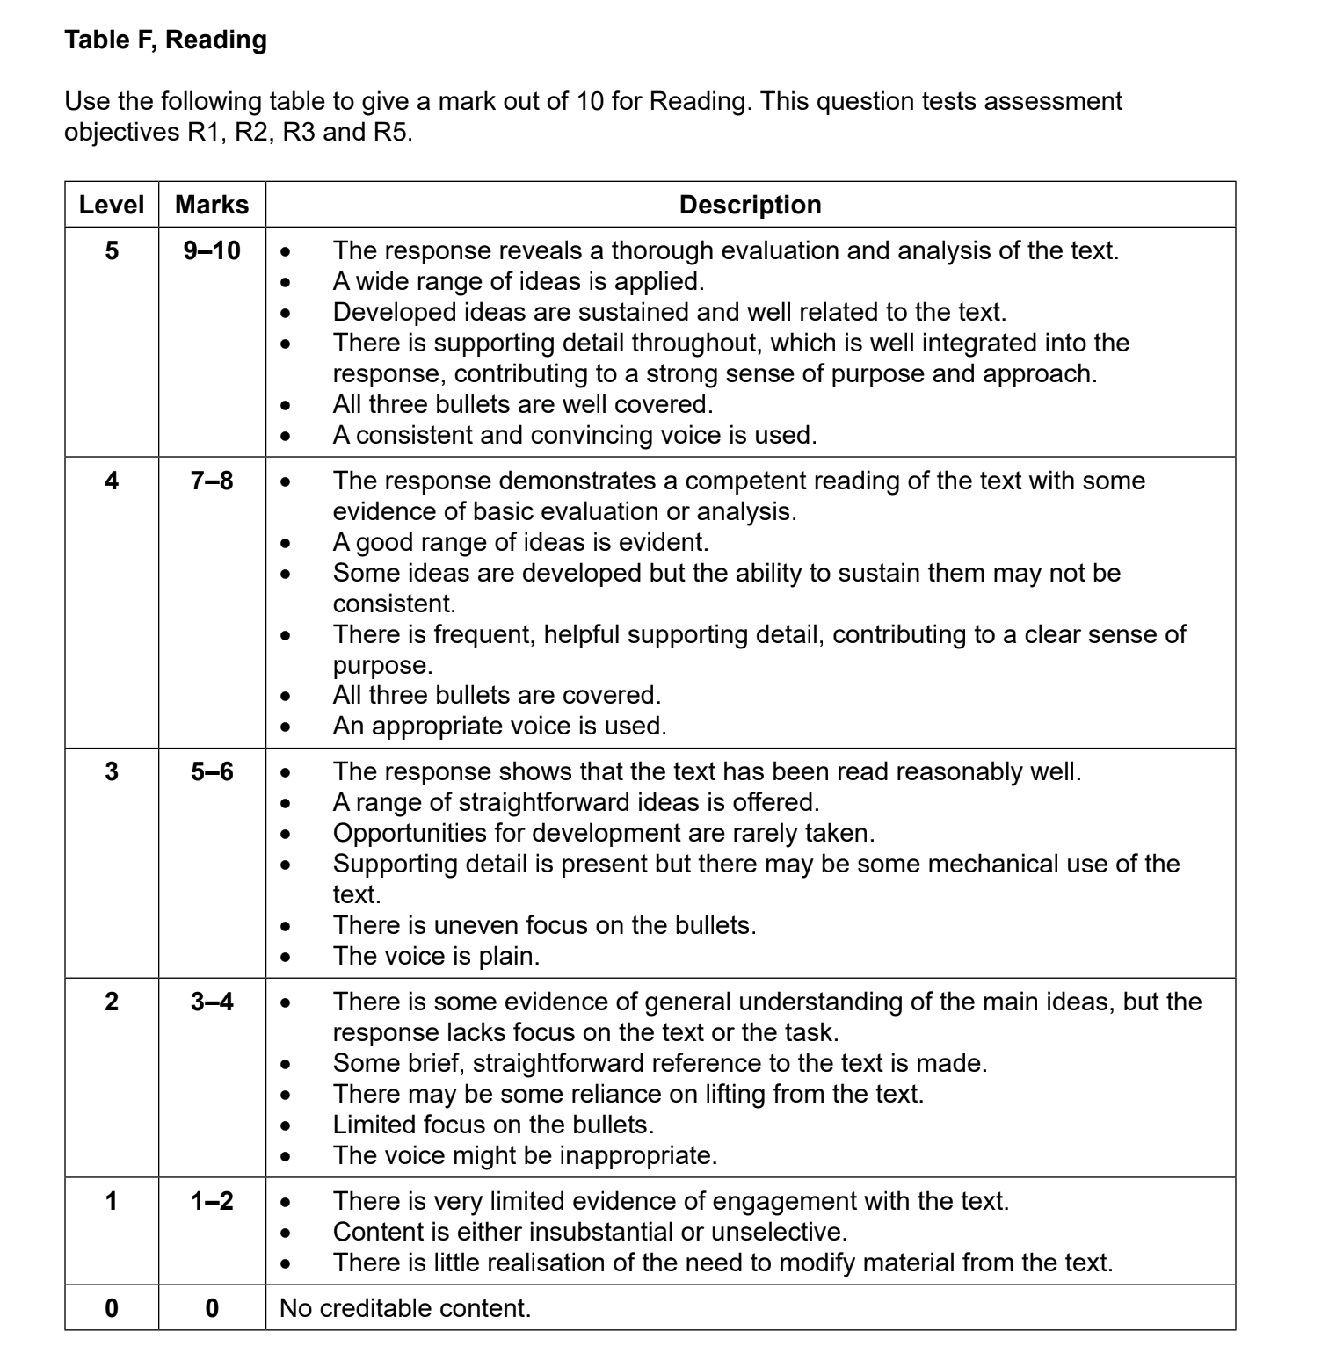
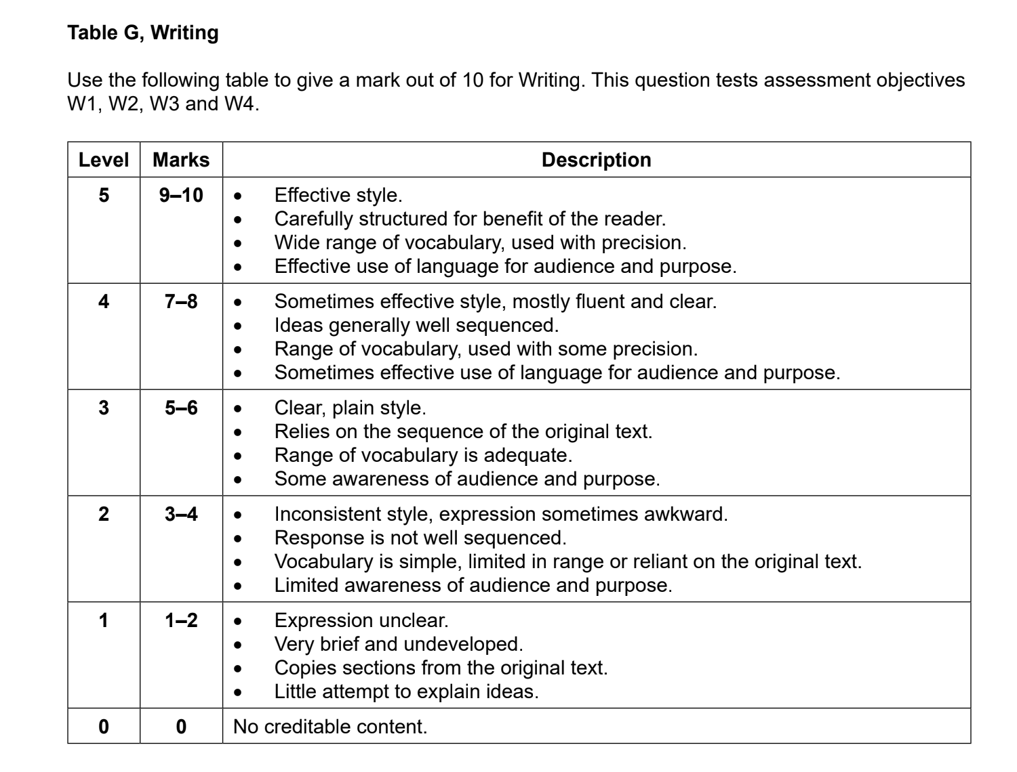
FLE Qu4
GENERIC
MARK SCHEME:

Slide 10
FURTHER RESEARCH RESOURCES ON TEXT TYPES for QUESTION 4 FLE RP:
First Language English IGCSE: Writing a Journal, Letter, Newspaper, Interview, Speech and Magazine
iGCSE First Language English - Extended Writing Response - All text types and their features!
Understanding Different Text Types: A Guide for IGCSE 0500 First Language English students - FirstLanguageEnglish.com
Section: | IGCSE Writing Skills text types - generic | Online Learning area - text types information and examples

Slide 11
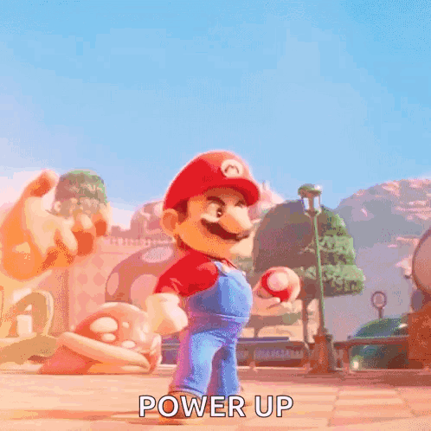
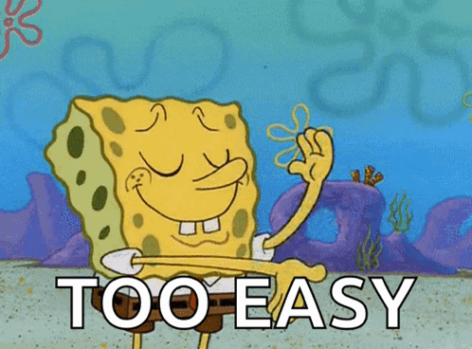
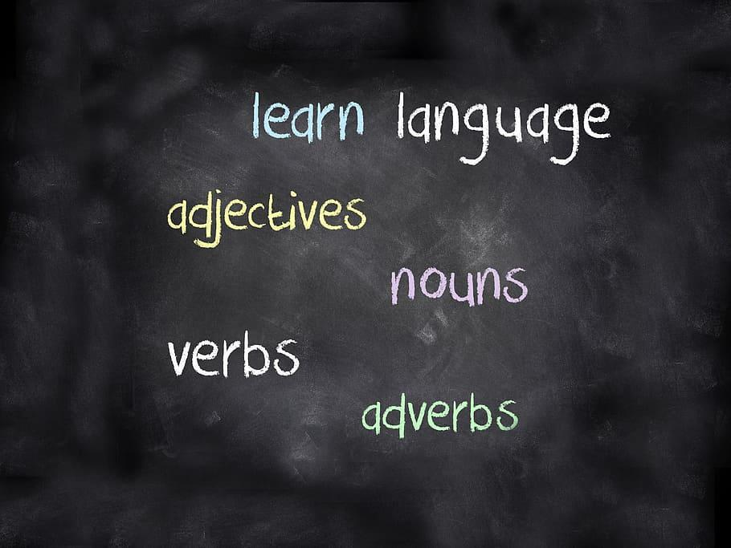
Act I, Scene IV: Mercutio
P
Point:
Evidence
Technique
Analysis
Audience / Reader Response
Link
E
T
Mastering this is the key to always providing good analysis and arguing a great point!
A
When analysing prose or poetry, make sure to clearly state your point, before quoting evidence with a identified technique to support your analysis. After analysing and explaining the relevancy of your evidence, comment on how audiences / readers interpret the technique and evidence before linking it back to your point!
A
L

Slide 12

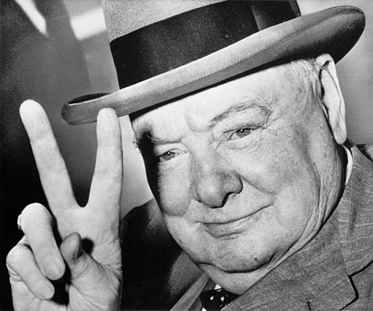
Victory Verbs!
“shows” is boring.
Go for victory in your essays by using a range of verbs to express your points.
The writer/play… |  | Opinion adjective | The language/structure… | The audience…
suggests | indicates | interesting (ly) | supports | infers
invokes | portrays | powerful (ly) | connotes | interprets
subverts | represents | vivid (ly) | validates | is impacted by…
implies | juxtaposes | thoughtful (ly) | enhances | deduces
highlights | contrasts | thought-provoking (ly) | evokes | establishes
presents | reflects | inspiring (ly) |  | wonders
attests to | emphasises |  |  | establishes
conveys | expounds
depicts | alludes to
demonstrates | illustrates
evinces | postulates
challenges | interrogates
.

Slide 13
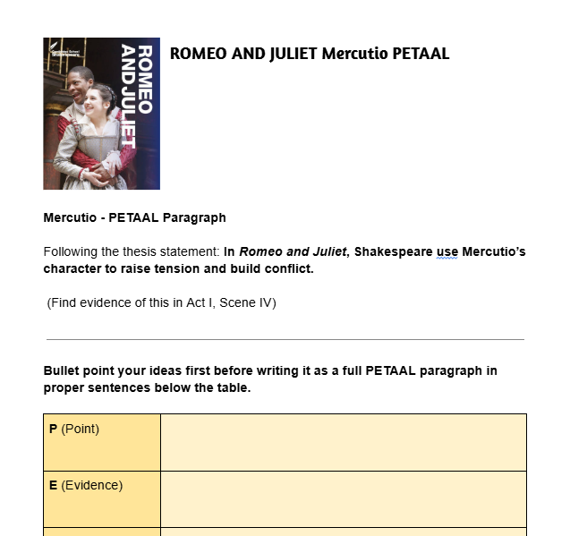
Act I, Scene IV: Mercutio
Critically Analysing…
REMINDER!
You will choose one quotation and write a PETAAL paragraph that links it to a thesis statement of Mercutio’s character builds tension and conflict in R&J
Analyse how the quote reveals qualities of Mercutio’s character
Remember - explaining what the word means does not get you any marks; you need to explain why it has been used and the impression it gives

